Slide 1
Case Study: Cat-Cheker Elimination
Rishabh Saxena(3838)
Confidential
DD-MMM-YYYY
John Smith

Slide 2
Topics/Agenda
01
｜
Problem Understanding
06
｜
Business Insights
02
｜
Data Preparation
07
｜
Conclusion
03
｜
Feature Engineering
04
｜
EDA & Hypothesis Validation
05
｜
Model Building & Prediction

Slide 3
Problem Statement
Client : Pet Care and pet food space.
Objective: To develop a solution approach to correctly classify the events as elimination or non-elimination.
Further classify the elimination events into urination and defecation

Slide 4
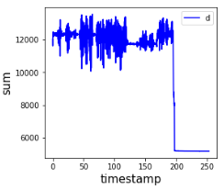
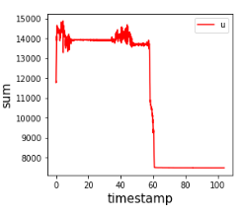
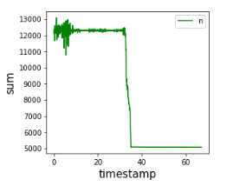
Data Provided
Load Sensor Data
Data contains timesteps and Load Sensor values
Tag Data
Data contains the information about the event such as cat name, event tags(urination, defecation, non-elimination) , free text etc.

Slide 5
01
Data Preparation

Slide 6
From CSV:
There are 82 Device IDs
Each event has one csv and json
In csv data, 4 load sensor values is given with timestamp
End value of timestamp is correspond to total time \
Features are added before merging with json
Merging Key is Event_ID
From JSON:
Json data has tag label which represents elimination (defecation and urination) and non-elimination.
Target column is derived from tags ('1': elimination and '0': non-elimination)
Hence for Model 1 target variable is elimination(1) vs non-elimination(0) and for Model 2 target variable is Urination(0) vs defecation (1)
Name of cat and Weight of cat are added in final dataset while Free Text and Tare weight are having lot of null values

Slide 7
02
Feature Engineering

Slide 8
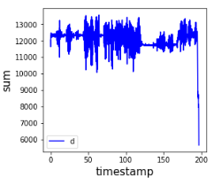
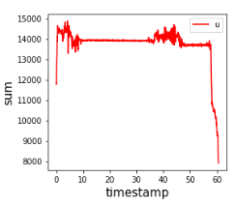
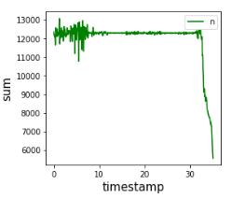
Capturing Activity time features
From the plots it is evident that after certain time period,
sensor data is not showing fluctuations
load sensor data is captured till fluctuation part.
Observations:
In case of defecation, load sensor fluctuations are higher than urination and non-elimination.
Resting time between two fluctuation is greater during urination activity.
It is observed that generally defecation activity is taking more time than urination and non-elimination
To capture the details of load sensor fluctuation during activity time binning is performed.
following features are calculated: mean activity load, standard deviation, peak activity load, load difference (w_diff) etc.

Slide 9
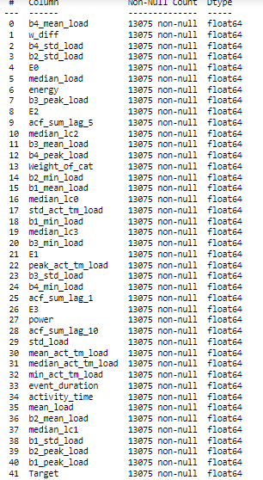
Feature Engineering
Features extraction during event duration : median_lc0, median_lc1, median_lc2, median_lc3, mean_load, std_load, max_load, Power, Energy, Autocorrelation factor(at lag=1,5,10)
Features like Mean, standard deviation, peak and min value at each bin is calculated
Final Data Shape: (13075, 41)
Null values are handled using KNN imputer.
Outlier Handling:
Histogram and Box plot is plotted for all the numerical features.
Flooring and capping is done on b1_min_load, min_act_tm_load, w_diff, Weight of cat
Transformations are performed on skewed features such as b4_std_load, b2_std_load, E0, energy, E2, E1, b3_std_load, E3, b1_std_load
There are no duplicates rows and columns

Slide 10
03
EDA & Hyothesis Validation

Slide 11
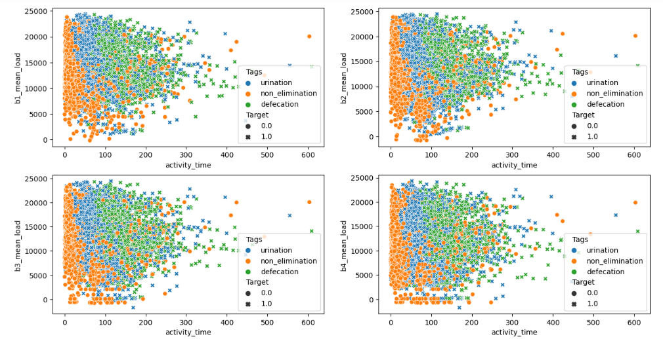
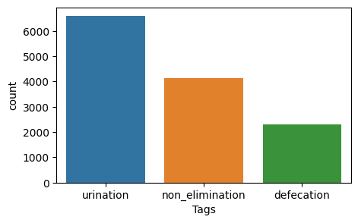
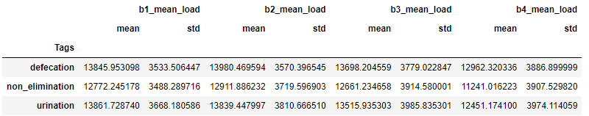
Load vs Event duration during Cat activity
Observation:
During elimination activities mean of load sensor values are higher than non-elimination
During elimination activities mean of activity time is higher than non-elimination
Urination activities are more compared to defecation and non-elimination

Slide 12
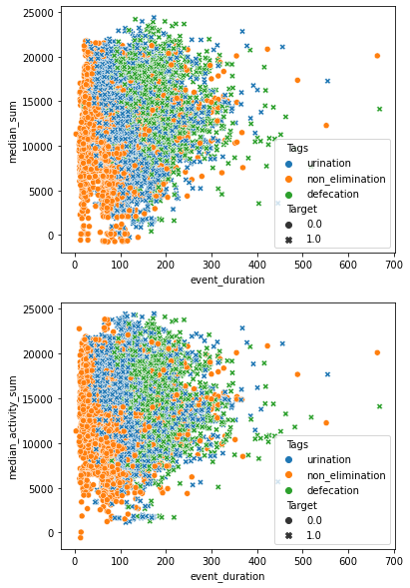
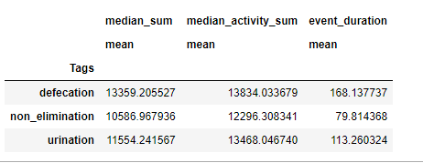
Load vs Event duration during Cat activity
Observation:
Non-elimination activities at the bottom which means least time is consumed during this activity and at the top defecation activity.
Mean of load sensor values is less in case of non-elimination activity and highest for defecation activity.

Slide 13
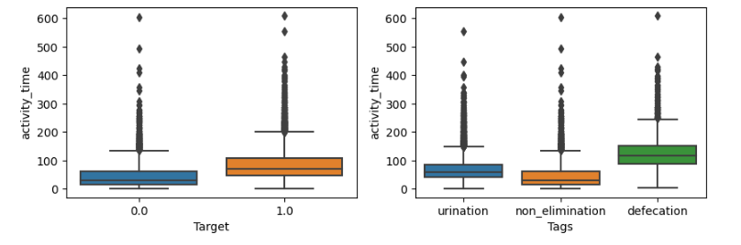
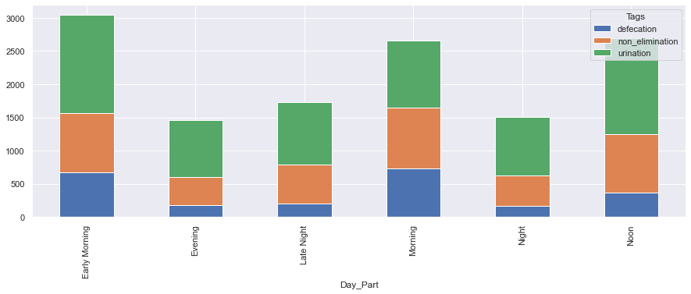
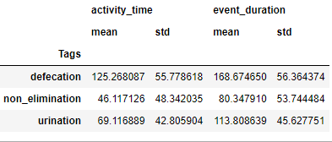
Relationship between Activity time with Target
Activity time vs Target
Day_part vs Target
Observation:
In day part during early morning and morning time cats are having maximum activity.

Slide 14
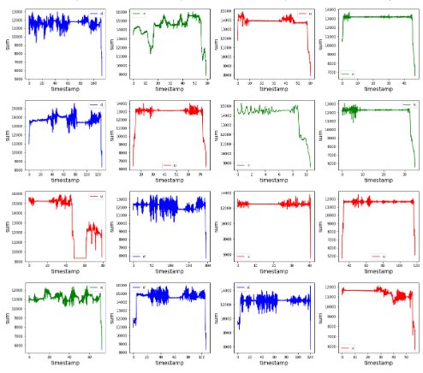
Visualization of raw signals for different activities
Observations:
It is observed that activity time for defecation is longer than urination and non elimination.
It is evident that in case of defecation, fluctuations in load sensor values are higher as compared to urination and non-elimination. standard deviation will be a good feature to capture spread in data.
In the plots corresponding to urination, we can see a common pattern having fluctuation, flat line, fluctuation, sudden drop(cat leaving the litter box). These patterns continue for a reasonable amount of time.

Slide 15
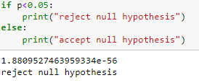
Statement: Do the statistical measures of load sensor data differ for each activity?
Hypothesis Creation:
# H0: During elimination activities mean of load sensor values is similar to non-elimination
# H1: During elimination activities mean of load sensor values is not similar to non-elimination
Hypothesis Test: ANOVA Test
Hence, Mean of load sensor values is not similar to each activity.

Slide 16
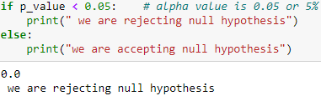
Statement: Does digging up and covering activity differ between urination and defecation?
Hypothesis Creation:
# H0: During digging up and covering activity load sensor values and activity time will not change between urination and non-elimination
# H1: During digging up and covering activity load sensor values and activity time will change between urination and non-elimination
Hypothesis Test: T Test
Hence, during digging up and covering activity load sensor values and activity time will change between urination and non-elimination

Slide 17
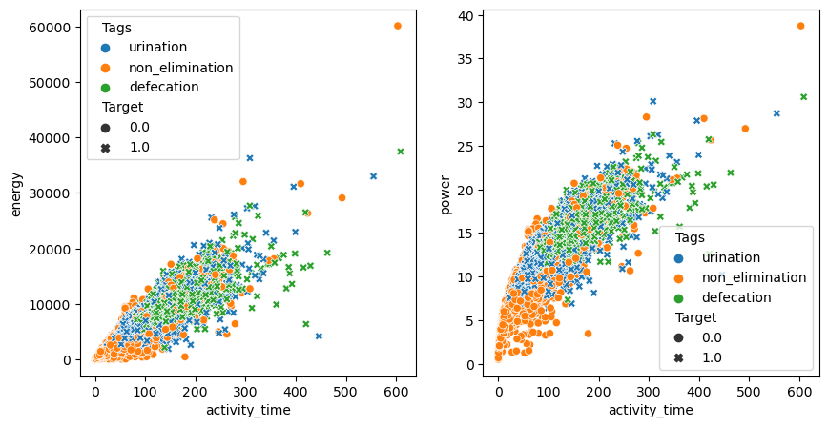
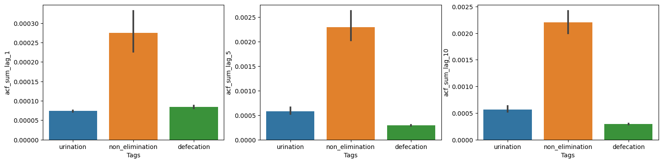
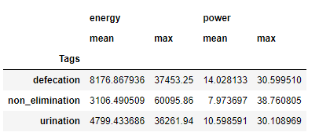
Relationship between Power/Energy and auto-correlation with Target
Load vs Target
Observations:
Energy and power features are positive correlated with activity time
Energy and power are higher for elimination activities.
Increasing the lag value of auto-correlation factor, it is decreasing for defecation activity

Slide 18
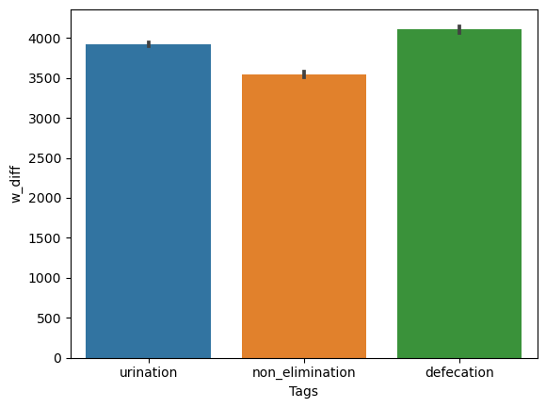
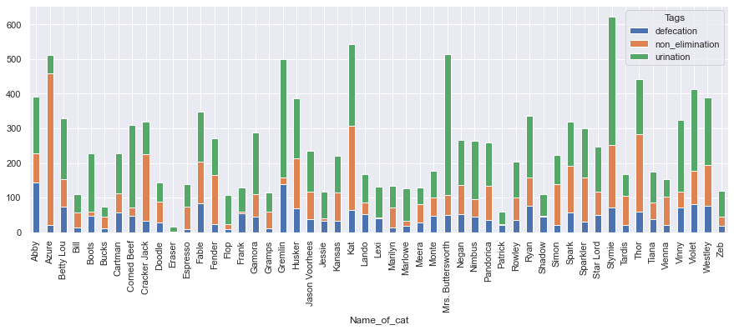
Cats Behaviour Patterns
Observations:
51 unique cat’s data is recorded in which 'Stymie' is appeared maximum times.
Urination is most common activity in cats, followed by non-elimination and defecation
W diff is least for non-elimination activity.

Slide 19
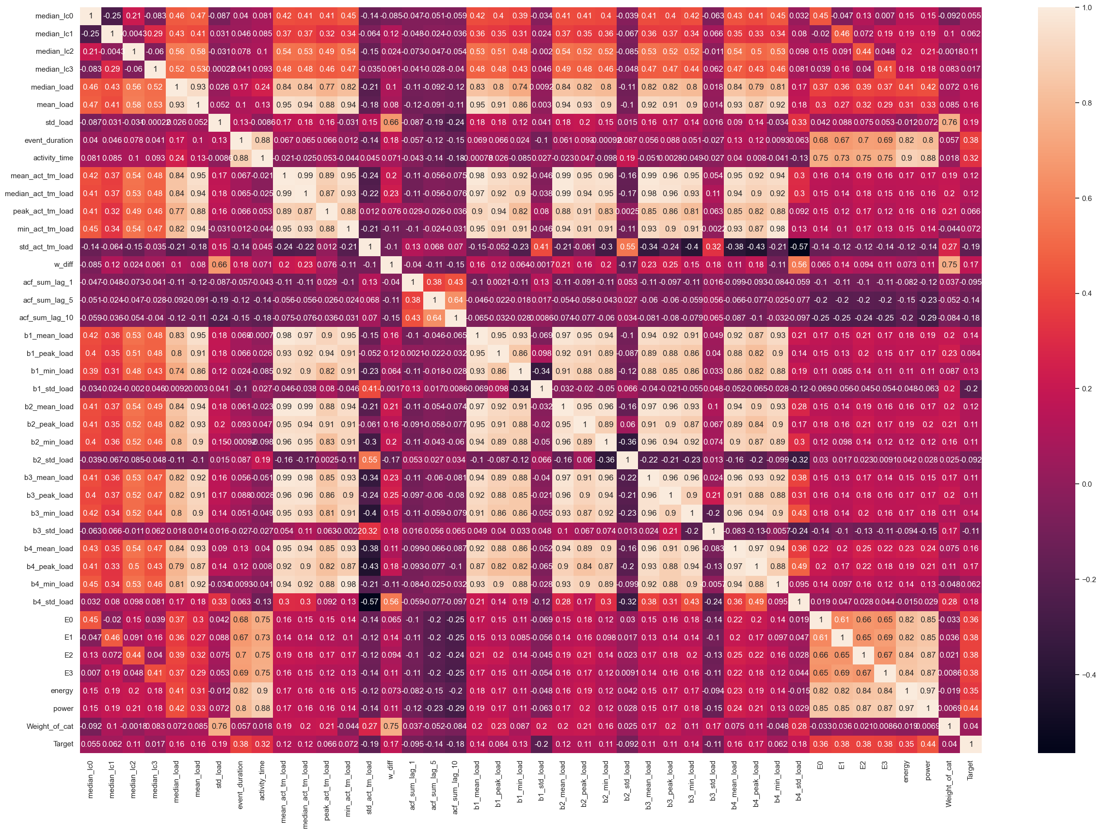
Correlation between variables
Observations:
Power, event duration, activity duration and energy(E0-E4) are showing strong correlation with Target.
b1_std_load, acf_sum_lag_10 and std_act_tm_load are negatively correlated with Target.
Mean sum, median_sum, mean_activity_sum, median_activity_sum, median_lc0, median_lc1, median_lc2, median_lc3 are are heavily correlated with each other.
Peak sum and peak_activity_sum are heavily correlated.
Power, mean_sum and median_sum are heavily correlated.
Power and energy are showing strong correlation.

Slide 20
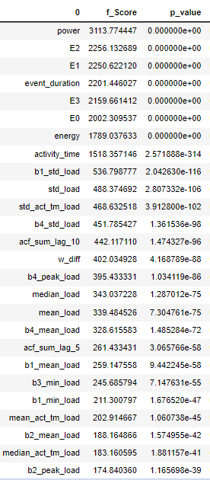
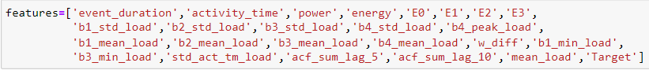
Feature Selection for Model 1
Features Selected:
From EDA results, Event duration, Activity time, Power, energy, w_diff, b1_std_load,b2_std_load, b3_std_load, b4_std_load are shown good results with target
F test is used as feature selection technique which gives importance to features based on statistical parameter.
From Correlation heat map best features are selected(having coeff >0.3).
If the features are not showing strong correlation(in this case >0.2) with target variable and showing high multicollinearity then it is dropped.

Slide 21
04
Model Building & Prediction

Slide 22
Model 1
Objective: To develop a solution approach to correctly classify the events as elimination or non-elimination.

Slide 23
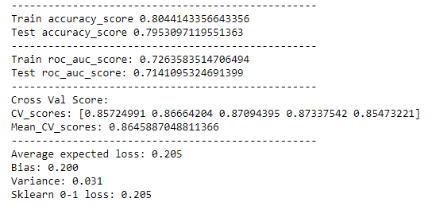
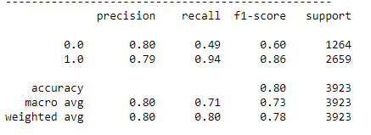
Model: Logistic Regression
Confusion Matrix
Test Data | Predicted 0 | Predicted 1
Actual 0 | 614 | 650
Actual 1 | 153 | 2506
Evaluation Metrics

Slide 24
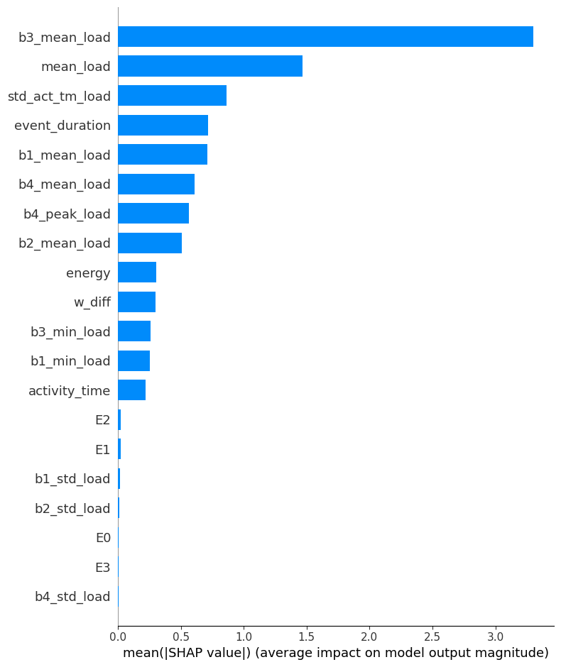
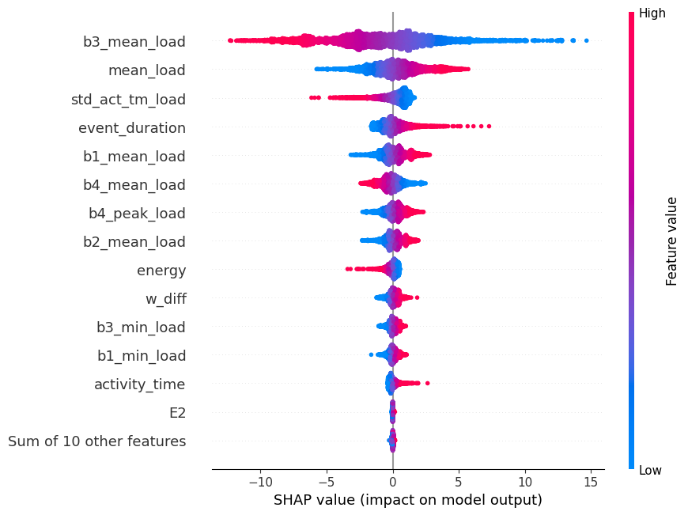
Feature Importance (using SHAP)
Selected Features based on F-score value:
Features: event duration, activity_time power, energy E0 E1 E2 E3, b1_std_load , b2_std_load, b3_std_load, b4_std_load, b4_peak_load, b1_mean_load, b2_mean_load, b3_mean_load, b4_mean_load, w_diff, b1_min_load, b3_min_load, std_act_tm_load ,acf_sum_lag_5, acf_sum_lag_10, mean_load

Slide 25
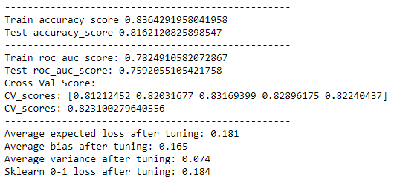
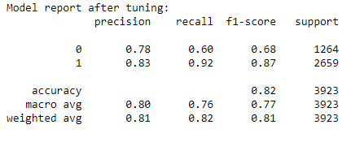
Model- Decision Tree
Confusion Matrix
Test Data | Predicted 0 | Predicted 1
Actual 0 | 757 | 507
Actual 1 | 214 | 2445
Evaluation Metrics

Slide 26
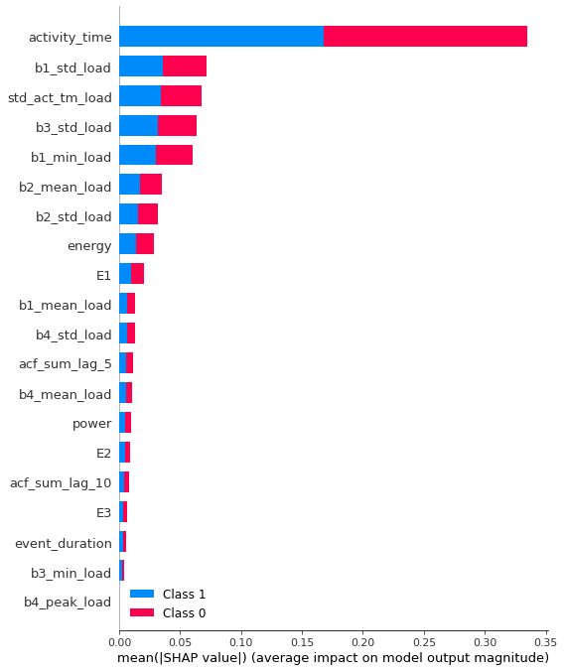
Feature Importance (using SHAP)
Selected Features based on F-score value:
Features: event duration, activity_time power, energy E0 E1 E2 E3, b1_std_load , b2_std_load, b3_std_load, b4_std_load, b4_peak_load, b1_mean_load, b2_mean_load, b3_mean_load, b4_mean_load, w_diff, b1_min_load, b3_min_load, std_act_tm_load ,acf_sum_lag_5, acf_sum_lag_10, mean_load

Slide 27
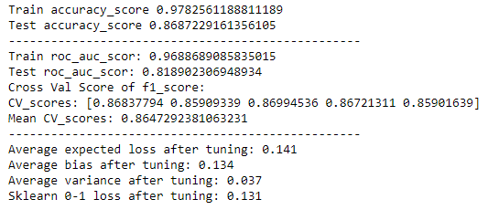
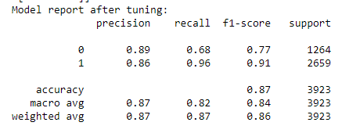
Model- Random Forest
Confusion Matrix
Test Data | Predicted 0 | Predicted 1
Actual 0 | 858 | 406
Actual 1 | 109 | 2550
Evaluation Metrics

Slide 28
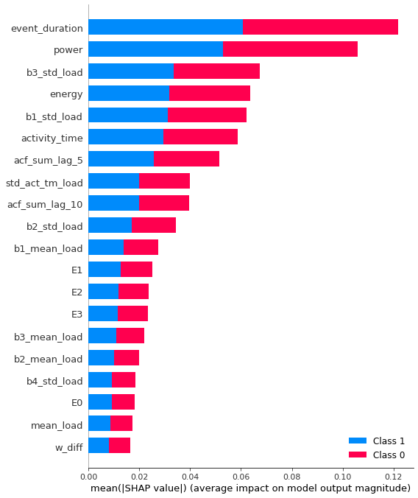
Feature Importance (using SHAP)
Selected Features based on F-score value:
Features: event duration, activity_time power, energy E0 E1 E2 E3, b1_std_load , b2_std_load, b3_std_load, b4_std_load, b4_peak_load, b1_mean_load, b2_mean_load, b3_mean_load, b4_mean_load, w_diff, b1_min_load, b3_min_load, std_act_tm_load ,acf_sum_lag_5, acf_sum_lag_10, mean_load

Slide 29
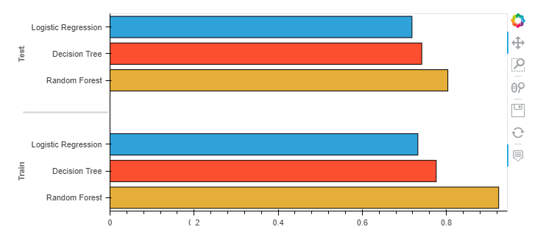
Model 1 Comparison
Metric | accuracy | f1_score | precision | recall | roc_auc | CV score | Bias | Variance
Logistic Regression | 0.798 | 0.781 | 0.8 | 0.75 | 0.718 | 0.86 | 0.202 | 0.031
Decision Tree | 0.820 | 0.81 | 0.81 | 0.80 | 0.742 | 0.826 | 0.156 | 0.085
Random_Model | 0.869 | 0.848 | 0.87 | 0.84 | 0.804 | 0.866 | 0.132 | 0.039
Observations:
Implemented Logistic Regression, Decision Tree and Random Forest models
Random Forest is giving best results
Accuracy, precision, recall and F1 score of Random forest classifier is higher than other two models
Random forest is showing low bias and low variance comparing with other two
Feature importance in case of random forest is matching with initial f-test score values

Slide 30
Model 2
Objective: Classify the Elimination events as Urination and defecation

Slide 31
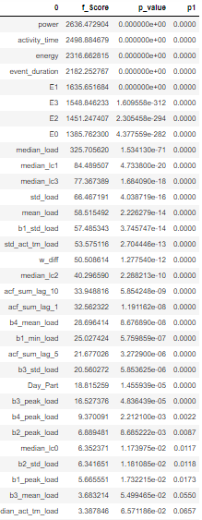
Feature Selection for Model 2
Features Selected:
activity_time, event_duration, power, energy, E0,E1,E2,E3, median_load, std_load, acf_sum_lag_1, acf_sum_lag_10, b1_std_load, median_lc1, median_lc2, median_lc3, std_act_tm_load
Total: 17 features
From EDA results, Event duration, Activity time, Power, energy, w_diff, b1_std_load,b2_std_load, b3_std_load, b4_std_load are shown good results with target
F test is used as feature selection technique which gives importance to features based on statistical parameter.
From Correlation heat map best features are selected(having coeff >0.3).
If the features are not showing strong correlation(in this case >0.2) with target variable and showing high multicollinearity then it is dropped.

Slide 32
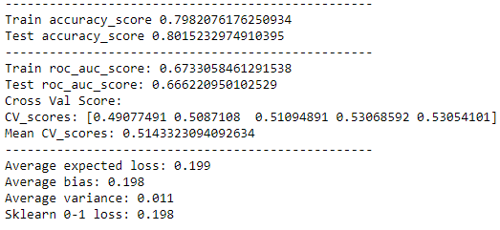
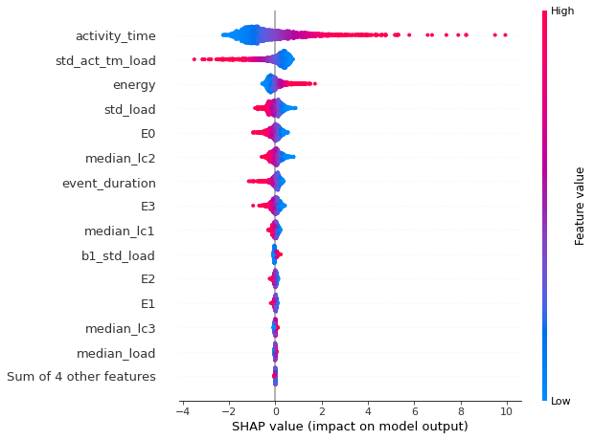
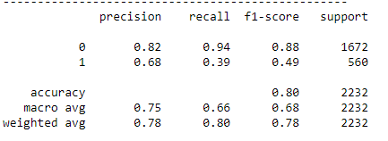
Model 2: Logistic Regression
Confusion Matrix
Test Data | Predicted 0 | Predicted 1
Actual 0 | 1568 | 104
Actual 1 | 339 | 221
Evaluation Metrics

Slide 33
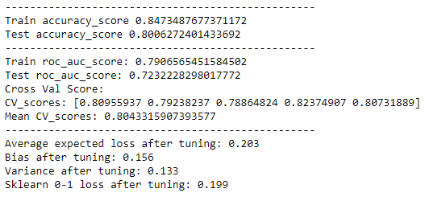
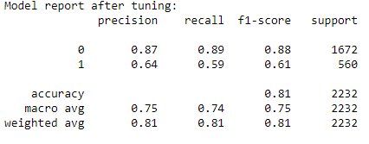
Model 2: Decision Tree
Confusion Matrix
Test Data | Predicted 0 | Predicted 1
Actual 0 | 1469 | 203
Actual 1 | 242 | 318
Evaluation Metrics

Slide 34
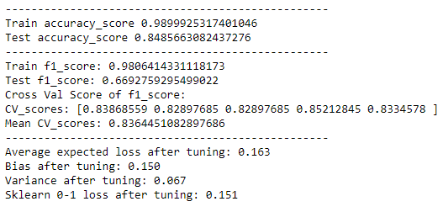
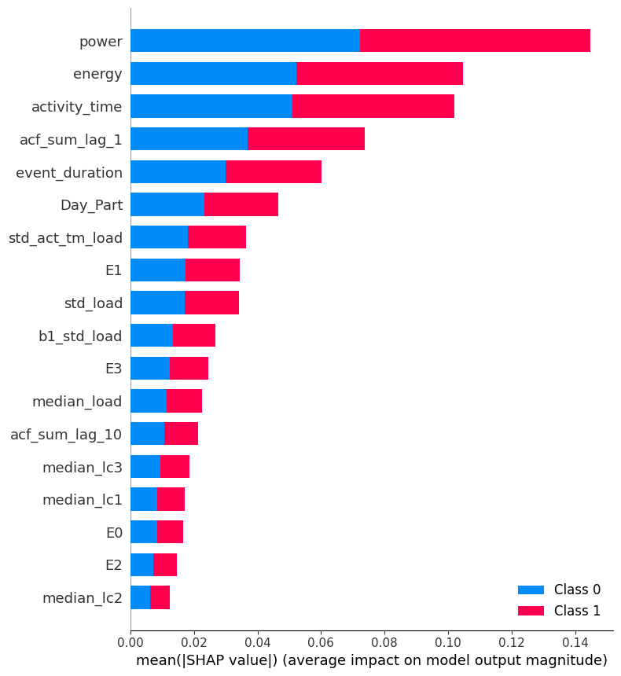
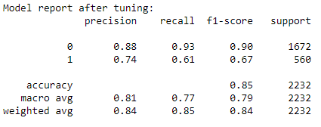
Model 2: Random Forest
Confusion Matrix
Test Data | Predicted 0 | Predicted 1
Actual 0 | 1552 | 120
Actual 1 | 202 | 358
Evaluation Metrics

Slide 35
Model 2 Comparison
Metric | accuracy | f1_score | precision | recall | roc_auc | CV score | Bias | Variance
Logistic Regression | 0.80 | 0.78 | 0.80 | 0.78 | 0.66 | 0.51 | 0.199 | 0.011
Decision Tree | 0.81 | 0.81 | 0.81 | 0.81 | 0.72 | 0.80 | 0.160 | 0.112
Random_Model | 0.85 | 0.83 | 0.84 | 0.85 | 0.74 | 0.836 | 0.150 | 0.067
Based on evaluation metrics and feature importance RF model is selected.

Slide 36
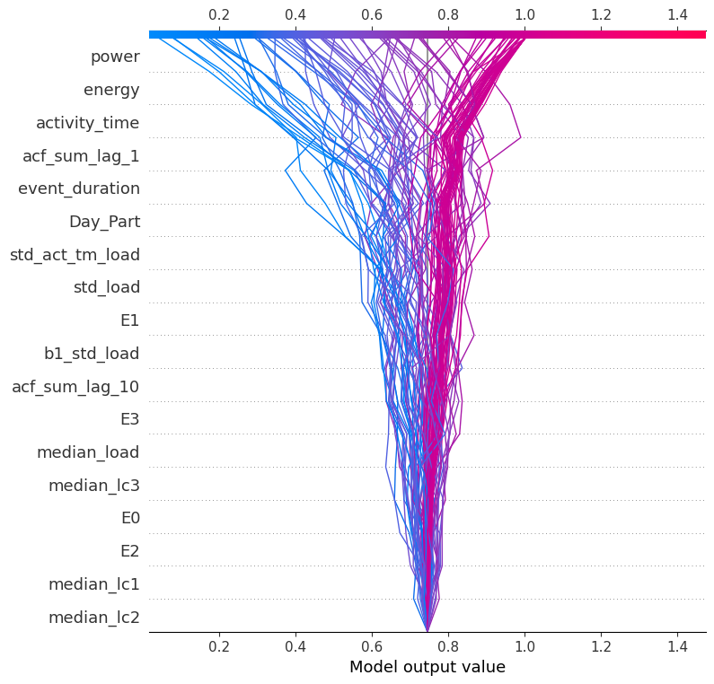
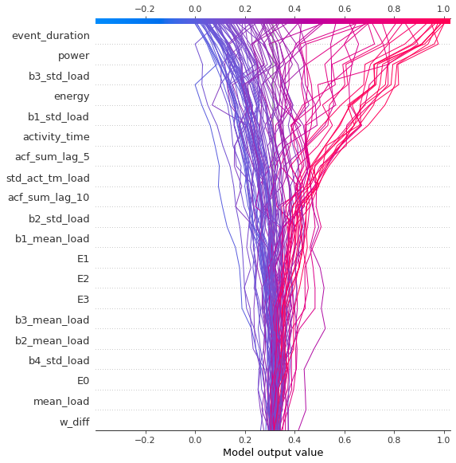
Error Analysis (Model RF1 & 2)
Decision plot: Model RF 1
Decision plot: Model RF 2

Slide 37
Business Insights
Time series load sensor data is an important source of information for cat activity prediction.
Details of activity(free text) could be an important feature for tagging cat event.
Top features (activity time, power, energy, load sensor mean, std) are deciding factors to predict cat’s activity .
Elimination and non-elimination activity gives an idea about pet’s health. Hence any malfunction in load sensor values can mislead about activities.
More load sensors can provide more precise information about cat’s activity, but price of product will become high.

Slide 38
Conclusion
Load sensor values will be different for elimination and non-elimination case hence any statistical transformation data will also differ for each activity.
Urination is most common activity among cats.
The patterns are not similar across different cat morphology.
Activity time is highest for defecation activity followed by urination and non-elimination.
Statistical measures(mean, variance) varies for each cat activity.
Power, Activity time, Energy(E0-E4), b1_std load etc. are the best features .
Random Forest gives best results in both cases with low bias and low variance.

Slide 39
Thank You
Do you have any questions?
Name
addyouremail@tigeranalytics.com
Add you phone number

